Slide 1
Introduction to Economics

Slide 2

What is economics?
Economics is the study of how society uses resources including how they produce and consume goods and services.
When we talk about economics, we need to differentiate between two different but interrelated parts. These are macroeconomics and microeconomics.

Slide 3
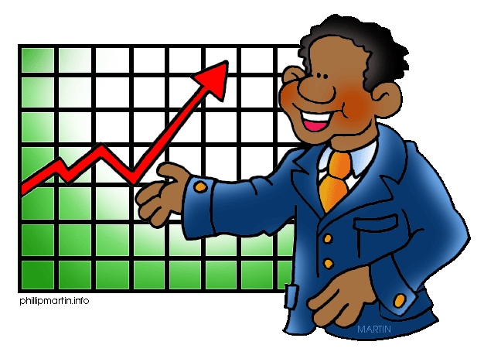
Macroeconomics This refers to the way Australia, as a nation, functions economically. There are many factors which affect the economy. Some things are:
Inflation - A general increase in prices and fall in the purchasing value of money
Unemployment - the state of being without a paid job but available to work
Monetary Systems - A set of things related to money or currency working together as parts of an interconnecting network.
Economic Growth - When Australia has produced more goods and services than the year before, economic growth occurs. In order to produce more, however, we need more resources.

Slide 4


What are resources?
In order to be able to produce (make) things to consume, we need to use something called resources. Resources can be classified into 3 categories:
Natural - all the raw materials and other natural resources that go into the production of goods and services. It is a broad concept that includes minerals dug up from the earth, food crops ready for processing, timber harvested from forests, and raw fibres such as wool or cotton that are available for processing into clothing.
Human - skills and effort required in the production process. It includes the physical effort contributed by a builder or process worker in a factory, and the intellectual skills applied by a computer programmer.
Capital - all the equipment (machinery, buildings, tools) used by human labour in the process of production.

Slide 5
Economic Growth How do we grow our economy?
Buy ‘Australian Made’ goods - Australia’s economy grows when people spend more on Australian made products. Economic growth influences our standard of living. When there is more money in the Australian economy, our standard of living rises.
Export goods to other countries - Exporting brings money back into the Australian economy. This money is then used to provide more goods and services, which also means a higher standard of living. The people who make these goods get an income from their job and then can spend that money in Australia.

Slide 6
Economic Downturn When an economy is not growing, we call this an economic downturn
Recession - When an economy has NOT experienced growth over a continuous period of 6 months or more, they are considered to be in a recession.
Unemployment - When people are unemployed (they do not have a job), they have less money to spend. When money is not being spent at businesses, it creates more unemployment. It is a cycle.
Standards of living - decrease in a recession (Standard of living refers to how much wealth and comfort is available to a person or community.

Slide 7

Microeconomics This refers to the behaviour of businesses and individuals, and the factors that influence purchasing decisions.
There are 3 important players in the microeconomy
Producers - A person, company, or country that makes, grows, or supplies goods or commodities for sale.
Consumers - A person who purchases goods and services for personal use.
Goods and Services - Goods are items you buy, such as food, clothing, toys, furniture, and toothpaste. Services are actions such as haircuts, medical check-ups, mail delivery, car repair, and teaching. Goods are tangible objects that satisfy people's wants.

Slide 8
Supply and Demand The amount of a commodity, product, or service available and the desire of buyers for it, considered as factors regulating its price.
Demand
Demand refers to how much (quantity) of a product or service is desired (wanted) by buyers. The quantity demanded is the amount of a product people are willing to buy at a certain price; the relationship between price and quantity demanded is known as the demand relationship.
Supply
Supply represents how much the market can offer or produce. The quantity supplied refers to the amount of a certain good producers are willing to supply when receiving a certain price. The correlation between price and how much of a good or service is supplied to the market is known as the supply relationship.
Price, therefore, is a reflection of supply and demand.

Slide 9

The laws of supply and demand impact on each of the following:
Price – the cost consumers pay for a product
Levels of production – the amount of a product that can be produced (manufactured/made)
Use of resources – the amount of resources that are needed and available to produce products

Slide 10

The Australian Economy
Australia’s economy can successfully progress when a balance is achieved in both the microeconomy and the macroeconomy. If any one part of the economy is not effective, it directly influences other aspects of the economy.
Governments have an important role to play when trying to What role do to achieve balance in the Australian economy.
Governments determine taxes. They then invest taxes back into Australia, building things such as schools, hospitals and roads. The way the government invests these funds, impacts our standard of living.

